Slide 1
NexxusETL 11 ADVANCED CONNECTOR
Handbook

Slide 2
Summary
INTRODUCTION 3
GETTING STARTED WITH NexxusETL 8
QUERY TAB 17
GLOBAL VARIABLES AND GLOBAL RESOURCES 21
JOB DESIGNER 23
COPY OPTIONS 55
ENTITY MANAGEMENT AND DYNAMIC FIELDS 63
SPECIFIC INTERFACES 77

Slide 3
Summary
DATABASE LOOKUP IN A MAPPING TASK 100
NESTED JOBS AND DATA CONTROL 105
STANDARD EXPORT PROCESS 119
SPECIFIC EXPORT JOB CREATION 129

Slide 4
Introduction

Slide 5




Introduction
The NexxusETL Workflow involves
Nexxus MI Master Application Server
Nexxus MI Database
MoveIt Platform
File Transfer, not remoted by NexxusETL
File Transfer, remoted by NexxusETL
ETL tasks, handled by NexxusETL
Tenant 1
Client’s Data
MOVE IT
Server
Database

Slide 6
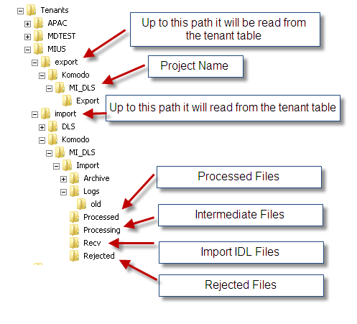
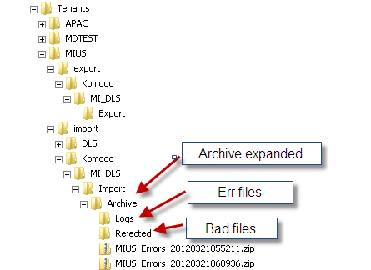
Introduction
A directory structure is dedicated to NexxusETL on the Nexxus MI Master Application Server

Slide 7

Introduction
Three Environments types are mandatory in a Standard Nexxus MI Project:
Configuration Sandbox
Test Sandbox
Production Environment
Standard Interfaces
Standard Interfaces must be tested on the Test Sandbox before being executed in Production
Specific Interfaces
Specific Interfaces must be created on the Configuration Sandbox then tested on the Test Sandbox before being imported in Production.
Configuration Sandbox
Test Sandbox
Production
C
T
P

Slide 8
Introduction (Reminder)
TENANT SETUP (FA)
Configuration Sandbox
Test Sandbox
Production
C
T
P
REFRESH SANDBOX (FA)
Configuration Sandbox
Test Sandbox
Production
C
T
P
CONFIGURATION
Configuration Sandbox
Test Sandbox
Production
C
T
P

Slide 9
Getting started with
NexxusETL

Slide 10
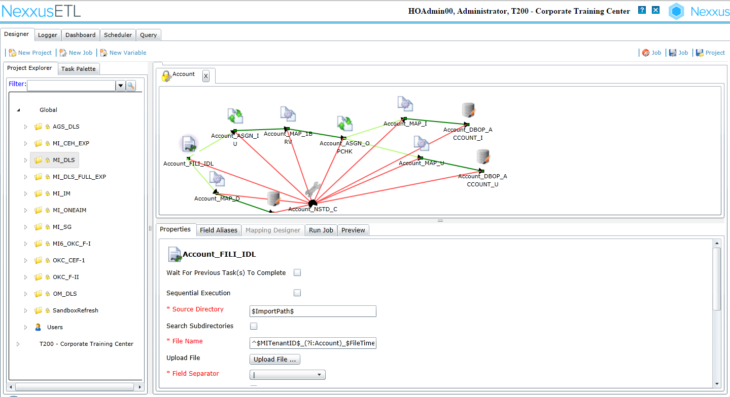
Getting started with NexxusETL
Basics
NexxusETL credentials are Tenant Limited
All elements from the Global Structure cannot be modified
The Tenant Dedicated Structure is empty by default
Save Job and Save Project buttons
The Project Explorer
The Global Structure contains Standard interfaces (DID or OneKey)
Specific Interfaces made of tasks can be created in the Tenant Dedicated Structure
Designer section
Preview of the files to load

Slide 11
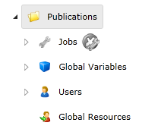
Getting started with NexxusETL
To create Specific Jobs, a specific project must be created on the Tenant Dedicated Structure
In the Project Explorer, Right click on the Tenant Dedicated Structure and choose New Project
A NexxusETL project contains 4 subdirectories:
Jobs: contains the specific jobs created for this project
Global Variables: contains variables available for all tasks of the project (such as: ExportRootPath and ExportFilePath for the source directory)
Users: contains the NexxusETL Users specifically created for this project
Global Resources: contains common resources for all tasks of the project (MI Database connection, MoveIt directory)
Project Name

Slide 12
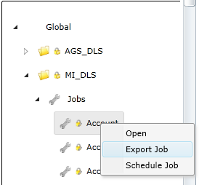
Getting started with NexxusETL
Global Resources and Variables are empty by default when creating a new project
The easiest way to recover Global Resources and Variables is to import a Job from the Global Structure
How to Export a Job from the Global Structure:
On the MI_DLS project, right click on the Job to Export it in an encrypted XML file.
All the Nested Jobs will be automatically exported too.

Slide 13
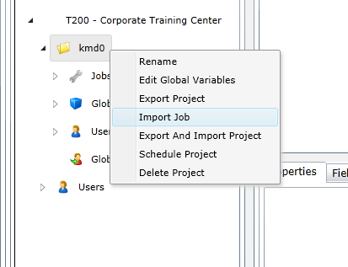
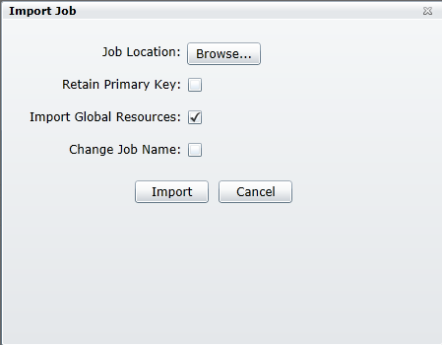

Getting started with NexxusETL
How to Import a Job in the Tenant Dedicated Structure:
1- Right click on your project name and choose Import Job
2- Select the xml file to Import and optionally enter the New Job Name.
3- Make sure to check Import Global Resources
4- Retain Primary Key should only be selected if Importing into a different Database (to preserve IDs between environment) – if importing into the same Database selecting this will throw an error.

Slide 14
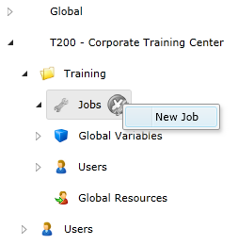

Getting started with NexxusETL
Selected reasons to Export/Import a Job:
Retrieve the Variables and Resources of another project
Modify a Standard DLS Job for specific needs
Backup your own jobs as there is no Save As or Undo in NexxusETL
Import a Job from the Configuration Sandbox to the Test Sandbox or to the Production environment
Xml export files are encrypted to ensure data security
It is also possible to create a brand new Job
To create a new job, open the Specific Project
Right click on Jobs and choose New Job
Jobs in the OneKey project
(MI_OKC_F-I or OKC_F-II or OKC_CEF-1)
should not be Exported and modified

Slide 15
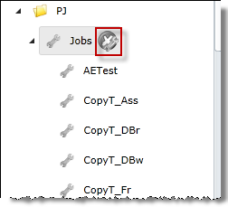
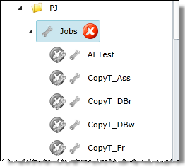
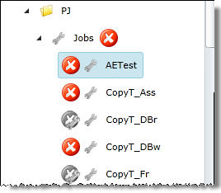
Delete Multiple jobs option
The option to delete jobs, across projects is available with proper project access.
1. The Delete Job icon is displayed at the job name node level for unlocked jobs in the Project Explorer.
2. Click to toggle from disabled to enabled
3. When enabled - delete icons will display to the left of the jobs
1 2 3

Slide 16
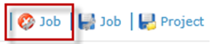
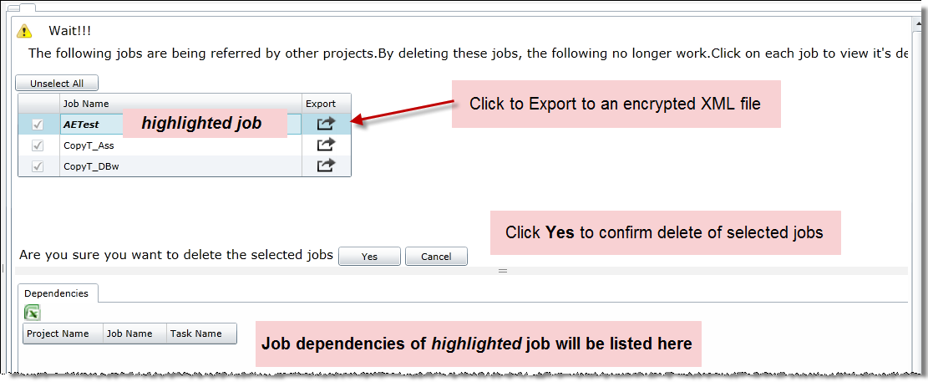
Delete Multiple jobs option
After all jobs have been selected for deletion click on the Job Delete icon from the top menu bar to open the Delete Jobs form.
Notes:
Job dependencies are a Direct link/reference

Slide 17
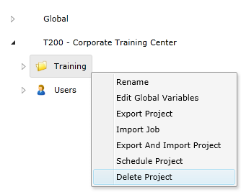
Delete Multiple jobs option
It is possible to delete project
Notes:
Job dependencies are a Direct link/reference

Slide 18
Query tab

Slide 19
Query tab
The Query tab allows the user to execute queries against tables and view the result set in NexxusETL
The Query tab option must be selected in the New User - Application Tabs for the logged in user
The SQL actions that can be executed by the user are also selected in the New User page under the Query tab
Those SQL actions are execute, select, insert, update and delete
Database connection resources must be created and saved prior to using the Query tab
To save the result set as a local .csv file click

Slide 20
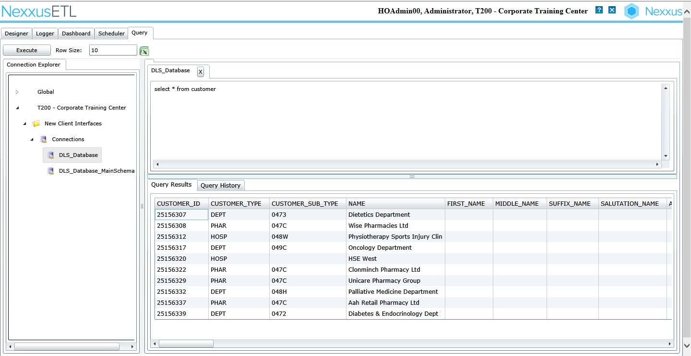
Query tab
Table filters assigned to the User will affect the Query result set

Slide 21
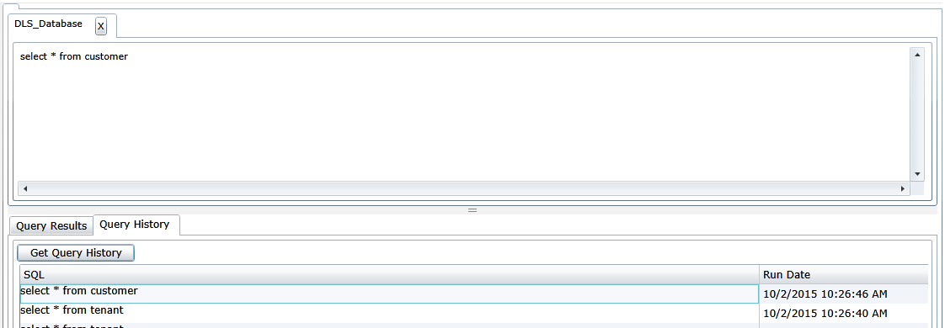
Query tab – Query history
To return a time stamped list of all the queries executed against this DB Connection, click the Query History tab and click Get Query History
To re-execute, double click on a SQL statement to copy it back to the execute statement area

Slide 22
Global Variables and
Global Resources

Slide 23
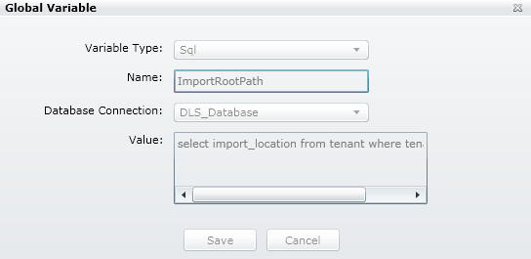
Global Variables and Global Resources
Using Global Variables simplifies the industrialization of the Jobs
Example of the Global Variable ImportRootPath.
This Variable is used to recover the path of the dedicated directory structure on the Application Server from the MI database.
There is no reference to the project name in the Variable ImportRootPath

Slide 24
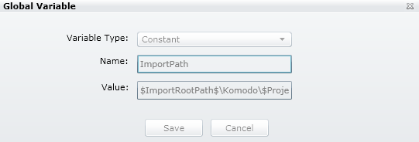
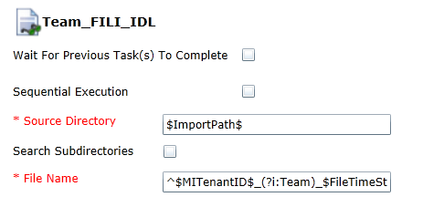
Global Variables and Global Resources
A Global variable can be used within other Global Variables. Here, for example, ImportPath adds the project name reference to the original ImportRootPath.
Then, this variable can be reused to setup several task properties
Its value will always be up to date.

Slide 25
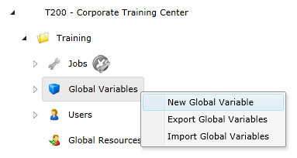
Global Variables and Global Resources
Global Variables Creation
Additional Variables can be created in a project of the Tenant Dedicated Structure.
Right click on Global Variable and choose New Global Variable
Variable names must be unique at the Project level.
$ is a reserved character and must not be used for names or values in global variables.

Slide 26
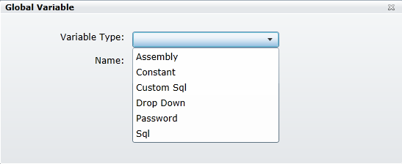
Global Variables and Global Resources
Global Variables Creation
A Variable Type must be selected
Required fields will vary depending on the Variable Type selected
List of available Variable Types:
Constant
Sql
Password
Dropdown
Assembly
Custom Sql

Slide 27
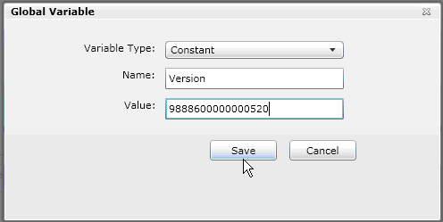
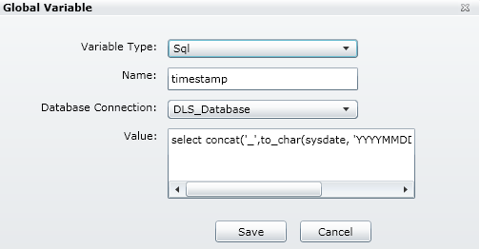
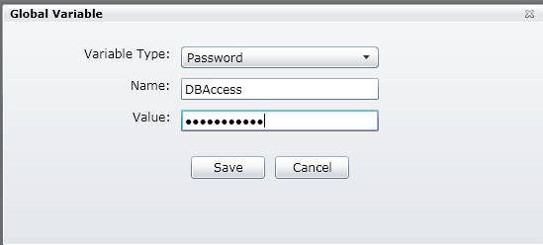
Global Variables and Global Resources
Constant
For an explicit and Constant value (‘ ‘ or “ “ not required for literal value)
Sql
To recover a value from the Database
(from the user’s tenant and tenant 0)
Value is the SQL statement
Database Connection is selected from
Global Resources
Password
A variable that is Password type will always
have its value masked

Slide 28
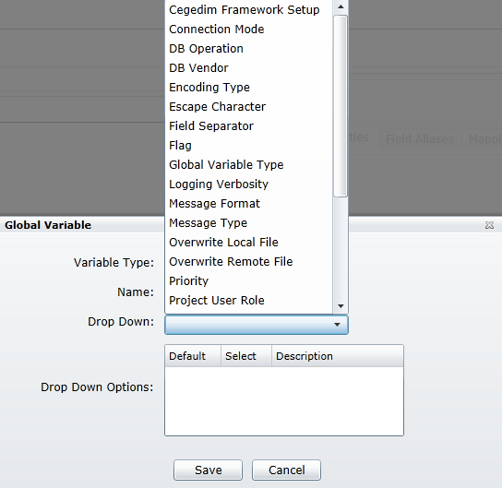
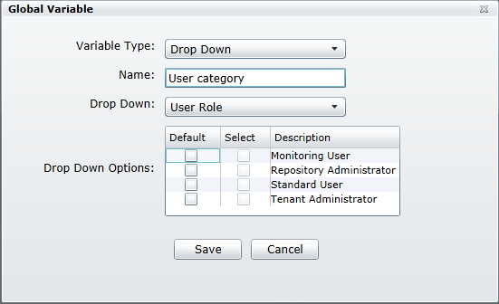
Global Variables and Global Resources
Dropdown
Extensive predefined list of parameters with
associated values that, if selected, will display
in a drop down control for selection in the Project
or Job Schedule form
Only one value can be selected as
the default – if multiple values are selected ,
the last value selected will be the default value
after a Save
Possible dropdowns (not exhaustive list)
Encoding Type
User Role
DB Vendor
Field Separator

Slide 29
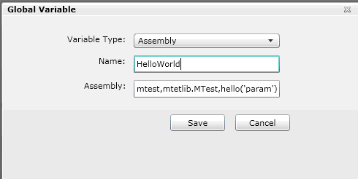
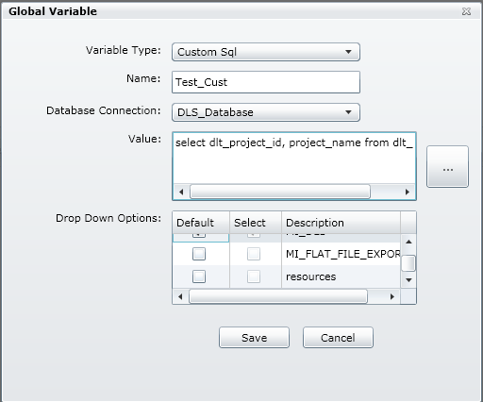
Global Variables and Global Resources
Assembly
Assigns a value based on the result of
a function call in the assembly/DLL.
Syntax:
dllname,Assembly.Type,function(‘parameter’)
Custom Sql
Assigns values based on the result of a SQL statement
Click… to execute SQL statement
Result set will populate the Drop Down Options

Slide 30
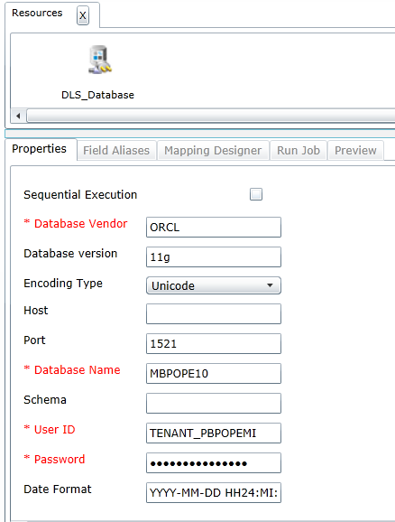
Global Variables and Global Resources
One or several Global Resources must be created in the tenant dedicated structure to build a new project.
The Global Resource DLS_Database opens a connection with the MI Database.
Connection string
User with Tenant restricted access
Date Format

Slide 31
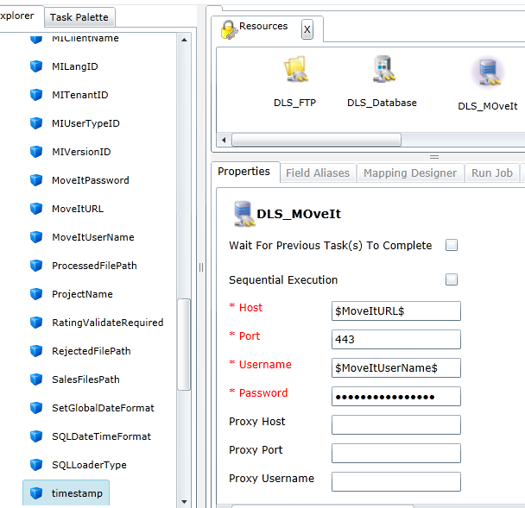
Global Variables and Global Resources
The Global Resource DLS_MoveIt opens a connection with the MoveIt directory.
This resource uses properties defined in the Global Variables
Note 1: It is possible to create New Global Resources
Note 2: the DLS_FTP Resource of the Global Structure is not enabled
MoveIt Url
MoveIt Directory

Slide 32
Job Designer

Slide 33
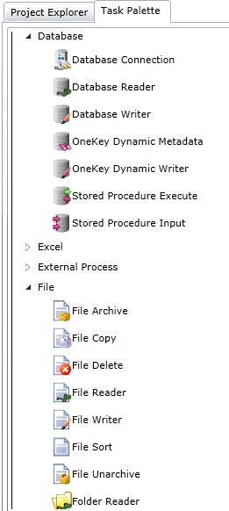
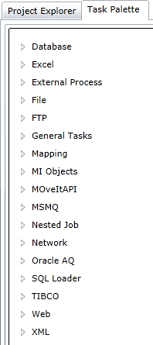
Job Designer
A Job is made of Tasks, linked together
Tasks are available in the Tasks Palette,
arranged by Category
To add a Task, drag and drop it from the Palette
to the Job Designer

Slide 34
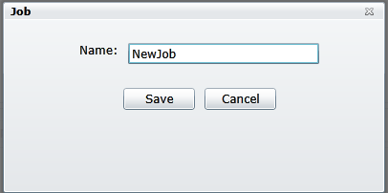
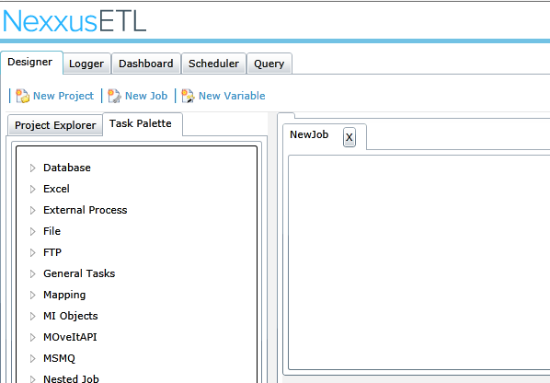
Job Designer
When you create and Save a new job the job will be opened in the designer tab

Slide 35
Job Designer
A task can be one of the following types
Producer: generates data that is passed to a target task through a task connector (e.g. File Reader, Database Reader)
Consumer: waits for data to come from the previous task and does not return data on successful processing of the received data (e. g. File Writer, Database Writer)
Both: accepts data and returns data upon successful processing, acting as a Producer and Consumer task. (e.g. Mapping)
Neither: does not need any data and will not pass any data via connectors. (e.g. File Copy or FTP Get)
Resource: This is a special type of task, it is used as a resource in property parameters by the above task types. They cannot be part of a job but are defined in Global Resources with a Project level scope. (e.g. Database Connection).

Slide 36
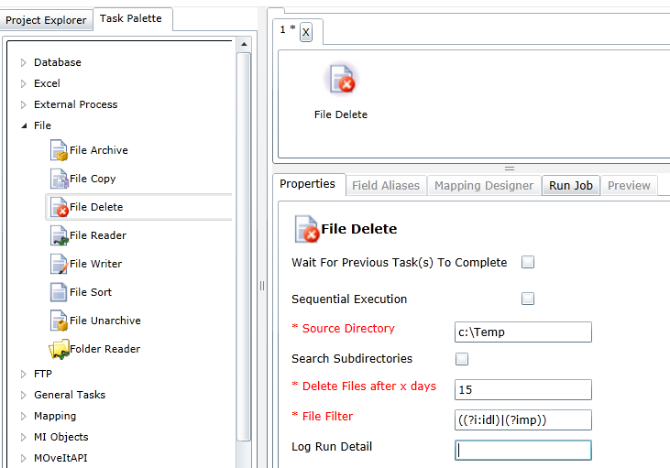
Job Designer
When drag and drop a task in the designer view, it is possible to edit its properties
For example: A File Delete task will delete files that match the File Filter
expression after a specific number of days (Delete Files after x days) have elapsed since the last update to the files in the Source Directory

Slide 37




Job Designer
Since MI10 The following tasks have been added
TASK NAME | ICON | CATEGORY
File sort |  | File
Folder Reader |  | File
Evaluate |  | General
Reset Framework Store |  | MI Objects

Slide 38
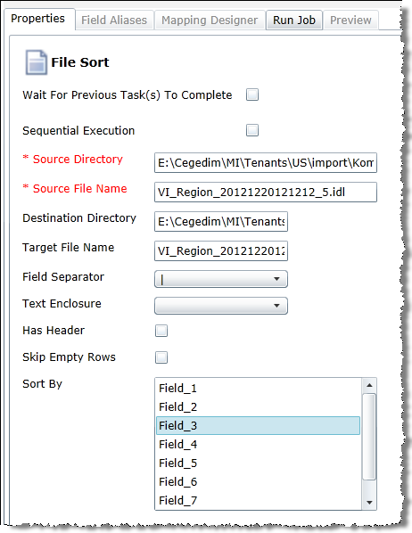
File Sort
Sort a file based on 1 to 3 fields. As the file is received the user can select which fields will be used to sort the data
The order in which they are selected will define the sort order
Notes:
Primary sorts first (region) secondary second (Role) will sort by Region and within region by role. It will allow you to select more than 3 fields– but will only sort on the first 3 selected.
To change sort, it is suggested to deselect all, save job and then reselect in correct order.
File, location and field separator must be entered to see fields- a save is not required. Ascending order only

Slide 39
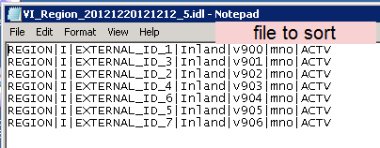
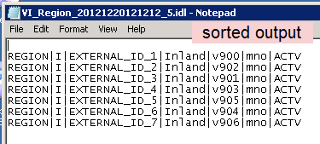
File Sort

Slide 40
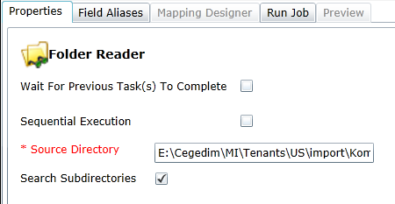
Folder Reader
The Folder Reader task will return the location and filename of the contents of a folder or folder with all subdirectories relative to the server
Complete Source Directory is E:\Cegedim\MI\Tenants\US\imports\Komodo\MI_DLS\Import\Processed
Notes:
Primary sorts first ( region) secondary second (Role) will sort by Region and within region by role. It will allow you to select more than 3 fields– but will only sort on the first 3 selected.
To change sort, it is suggested to deselect all, save job and then reselect in correct order.
File, location and field separator must be entered to see fields- a save is not required. Ascending order only

Slide 41
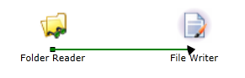
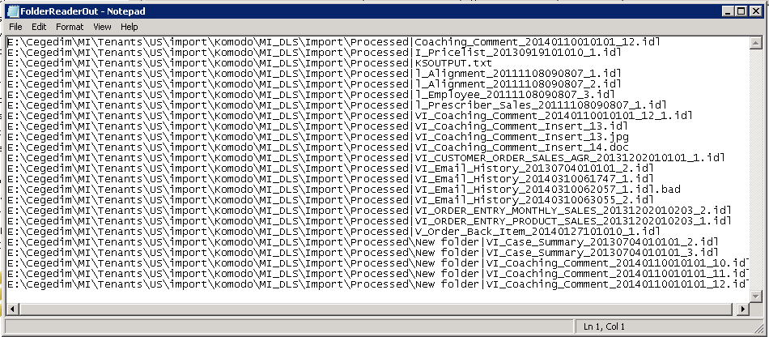
Folder Reader
Example of Folder Reader linked to a File Writer with an output File Name of FolderReaderOut.txt searching for all subdirectories
E:\Cegedim\MI\Tenants\US\imports\Komodo\MI_DLS\Import\Processed

Slide 42
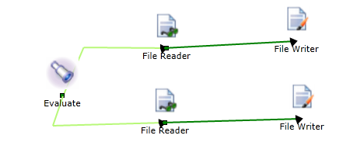
Evaluate
Evaluate is used at the start of a job to test a conditional link expression that will determine the flow of control in the job and improves performance
Conditional link 1
Conditional link 2

Slide 43
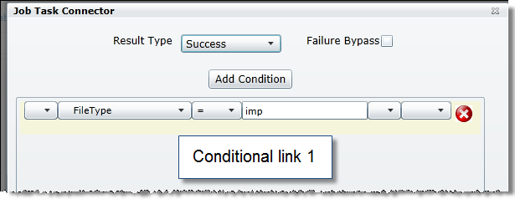
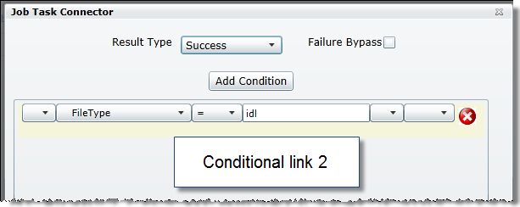
Evaluate
The Conditional link expression determines the flow of control in the job based on a Global Variable
Conditional link 1
Conditional link 2

Slide 44
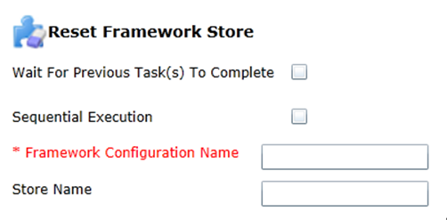
Reset Framework Store
A generic Framework Reset task that allows the user to specify which store should be reset
Notes:
Existing: AffiliationStore Reset, PropertyStore Reset, and CodeStore Reset

Slide 45
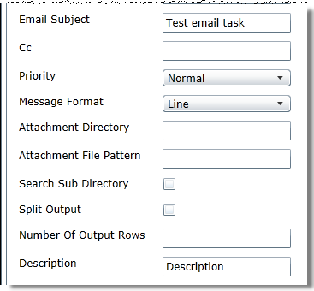
Enhanced Email task
Ten new fields have been added to the Email task
The default is to group all incoming records into one Email, you have the option to Split the Output into multiple emails based on the number Output rows per email.
The default settings are 100 rows per email with a maximum of 10 emails.

Slide 46
Enhanced Email task
Ten new fields have been added to the Email task
New Property | Value | Description
Email Subject | User Entered | Text that appears in email Subject Area
Cc | User Entered | Email Address of people to receive a CC of this email
Priority | Dropdown | Priority Choices are High, Low or Normal
Message Format | Dropdown | Choices are Grid, Line or ListView
Attachment Directory | User Entered | Directory location to search for the attachment, may be the location of output from a previous job
Attachment File Pattern | User Entered | Regular expression used to search for attachment
Search Sub Directory | Check Box | If selected sub directories of the Attachment Directory will be searched for files matching the Attachment File Pattern
Split Output | Check Box | If selected, will give you control over the number of rows in the body of an email and will allow multiple emails to be produced by this task. The maximum number of emails is 10
Number of Output Rows | User Entered | Default to 100, this is the number of rows allowed in each email body
Description | User Entered | This is the body of the email in addition to the records that are being passed in from previous tasks

Slide 47
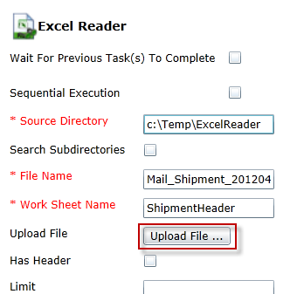
Excel Reader task
A File Upload button has been added to the task, similar to the File Reader Upload File button
This button allows you to browse and select an Excel file from your local directory and Upload to the server
Notes:
Worksheet name is required to preview the file, upload will work w/o filling in. Enter required information, click Upload, Choose File, Upload

Slide 48
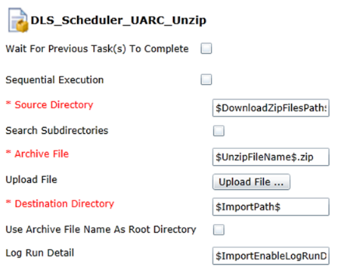
File Unarchive task
A File Upload button has been added to the task, similar to the File Reader Upload File button
This button allows you to browse and select an Excel file from your local directory and Upload to the server

Slide 49
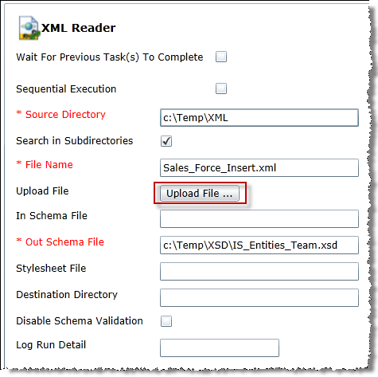
XML Reader task
A File Upload button has been added to the task, similar to the File Reader Upload File button
This button allows you to browse and select an xml file from your local directory and Upload to the server

Slide 50
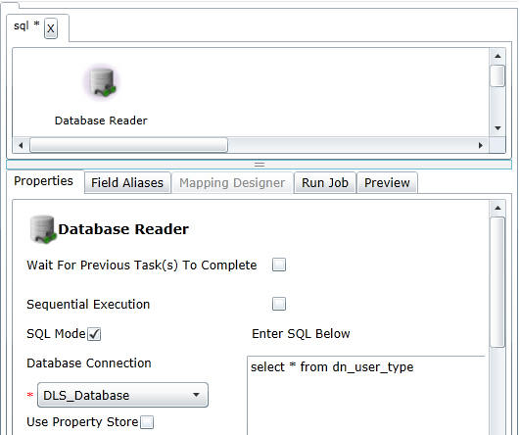
Job Designer
NexxusETL First Exercise : Query the Nexxus MI database using the Database Reader task within a specific job
1- Create a new Project
2- Import a DLS job
3- Check the variables and the resources
4- Create a job to query
Drag and Drop the Database Reader
Set to task to simply query the MI Database

Slide 51

Job Designer
The Designer tab contains a Job Canvas Panel for each Job.
This is the staging area for all tasks that make up the Job.
Connectors are used to join relevant tasks to create a continuous job workflow
Task names must be changed to a unique, descriptive name
Tasks and connections can be removed from the workflow
Unsaved changes to a job workflow are indicated with an * asterisk in the job tab
Multiple jobs can be opened and edited at the same time, indicated by multiple job tabs

Slide 52
Job Designer
Task Edition
Change Task Name
Double click on task name to display an editable text box Hint: A naming pattern to reflect the task type and data content is suggested
Delete Task
Right click on task icon, click Delete Task (related links will automatically be deleted)
Create Link (connector)
Right click on task icon click Create Link, then Drag & Drop link to connecting task
Delete a Task Connector
Right click on connector icon click Delete Link

Slide 53
Job Designer
Task Connectors can be edited to select one of the following type
Dark Green
The default Connector Type Straight transition, without condition
Light Green
Successful transition
associated with a condition
Red
Failure transition
Condition
Default
Failure

Slide 54

Job Designer
How to update the Connector Type
1- Double Click on connector to open the Task Connector form
2- Select the Result Type Success – normal data processing Failure – exception, data errors
3- Failure Bypass must be checked to continue processing even if this task fails
4- Chain conditions to defines the input data condition. This determines the processed record’s flow.

Slide 55



Job Designer
Option for link angles
Right click on link
(cursor must be pointing finger)
Select Add Corner
Select position on link to add angle –
(cursor must be pointing finger)
With left mouse button pressed
drag link to create angle,
release button to create angle
The Reset Corner option will
remove all angles associated with one link

Slide 56
Copy Options

Slide 57


Copy and Past of task with properties
The Copy Task option will copy the Fields, Field Alias settings and Properties tab from an existing task to a new task in the current job, a different job in the same project or a different job in a different project
The Copy Task option will not copy Mapping properties for a mapping task
Only a Super User can paste into a Global baseline job
Right click on a blank area in the job tab and click on the Paste From: task_name message, the syntax of : Tenant-project-job-task
1 2
Notes:
paste will be available after a job save – if pasting into another project you will be forced to save. The paste is available until a clear copy task (from any right click task). Only 1 task in clip board- the last copied overlays the previous

Slide 58

Copy From Tasks
Copy From Task option
Copies Fields and Field Alias properties from an existing task to a new, ‘similar’ task.
Will not copy the Properties page values
Not available for all tasks
Applies only for tasks that are not a “producer” type or tasks where selecting options does not result in fields generated
For example, you cannot copy fields for a File Reader task but a File Reader task can be used as the source for a File Writer or Database Writer task.
Possible Source tasks
Selected task

Slide 59


Copy Job to another project
The Copy Job option will copy a job and all it’s properties to a new project or to the same project with a new name
A shortcut version of the Job Export – Job Import – you will not have access to the .xml file
Right click on Job – click Copy Job
Enter target tenant and project, optionally change name (must be unique in target project)
1 2

Slide 60


Global Variable Export/Import
All Global Variables can be exported from one Project and then Imported into another
You don’t have the option to select individual Global Variables for Export/Import.
Process is similar to Job Export – exported XML file is encrypted
Options vary based on Project type- Global vs Non Global Tenant and user type

Slide 61
Global Variable Export/Import
Export the Global Variables into a local .xml file
Select the target project and Import the Global Variables in from the local .xml file
After a Global Variable Export/Import there is no link between the 2 projects, changes made to Global Variables in a project are encapsulated

Slide 62


Global Variable Export/Import
All Global Resources can be exported from one Project and then Imported into another
You don’t have the option to select individual Global Resources for Export/Import
Process is similar to Global Variable Export/Import – exported XML file is encrypted
Options vary based on Project type- Global vs Non Global Tenant and user type

Slide 63



Global Variable Export/Import
After a Global Resources Export/Import there is no link between the 2 projects, changes made to Global Resources in a project are encapsulated

Slide 64
Entity Management and
Dynamic Fields

Slide 65
Entity Management
What is an Entity?
An Entity is a set of properties describing a logical object managed by Nexxus MI. Examples include Customers, Employee, Teams, Alignments, Products, Calls…
Classic Configurators (Configurator Security Group) has access to view the Entity tree as well as to create layouts on an Entity level
In addition, the Advanced Configurator (Advanced Configurator Security Group) can add tables to Entities (included dynamic tables) and to create new Entities in the Nexxus MI Entity Management tool.

Slide 66
Entity Management
Working at the company level allows Smart Configuration: new sections can now be made on the Entity level and reused in several screens for the same entity (and child levels).
For example, it is best-practice to create a new section on the “Customer” Entity level and simply select the section at other Customer Levels: Medical Professionals, Institutions, Pharmacies, etc.
Entity’s Dynamic Fields must be managed in Entity Management to optimize data loading in NexxusETL.

Slide 67

Entity Management
Tools > Entity Management

Slide 68


Entity Management
The Entity Tree displays the root table for the Entity as well as the format of how the entity’s name is displayed
Updating the format of the Display Name will affect every place the entity’s name is displayed

Slide 69


Entity Management
See all of the tables (including dynamic and virtual tables) associated with the Entity
Using the ‘New’ button, it is possible to
Create a new dynamic table
Associate another table in order to make available a field that is not associated baseline
Notes:
Associations (via the New button) can be made here in order to make available a field that is not normally available for the table being consulted (here Med Prof).

Slide 70


Entity Management
Table Relationship
Click on table displays its relationship with the Entity
Then, it’s possible to use the following features
Fields editing
Layout Creation
Scripting at table level
Data Rules editing

Slide 71
Entity Management
Field Definitions: Displays all fields within the table and allows property editing
Layouts: Displays all associated layouts and allows new layouts to be defined
Table Scripting Events: Displays all scripts and allows new scripts to be attached to table events
Data Rules: Displays all data rules and allows new data rules to be defined

Slide 72

Entity Management
The PROPERTY ROLE defined the level in the Entity tree from which this field or the modification done on this field is available.
Property Role example: The customer.name field was originally defined at the “customer” entity to be labeled as “Name”.
It was then modified at the
“All Individuals” entity to be “Last Name”
All the sub-entities of the ‘All Individuals’
entity have inherited of this label
The field remains labeled as “Name” for
all Organizations.
Name
Last Name
Name

Slide 73


Entity Management
Use the New table button to:
Associate MI table to an entity that are not baseline associated. These fields are then available to add to an entity’s page.
Automatically create a new dynamic table

Slide 74
Entity Management
Table Type:
Dynamic – Choose this type to create new dynamic table
One To Many Relation – Choose this type to associate a MI table with a 1-to-Many relationship between entity and table
One To One Relation – Choose this type to associate a MI table 1-to-1 relationship between entity and table
Table Name - The name of the table to attach.
If Table Type was Dynamic, the name of the new dynamic table.
Dynamic creates dn_dynamic_table entry for dynamic table. New table will then show up in Entity Tables list for the entity. Properties can be defined for it. Layouts can be created for it which could then be added to other pages.

Slide 75


Entity Management
After saving
Table ID

Slide 76

Entity Management
Clicking Table Name link displays Table Details page
From there, fields can be edited
Reminder : Always use the first Text field for the External_ID
External_ID

Slide 77

Entity Management
A New Layout can be edited for the dynamic table
New section can be added and then new fields from the dynamic table can be added to section
Layout is then available for use throughout the application

Slide 78
Specific Interfaces

Slide 79
Specific Interfaces
Context
Create a Specific Job in the tenant dedicated structure of NexxusETL in order to load data into Dynamic Fields.
When Dynamic Fields are correctly created in Entity Management, the Job can be easily set thanks to the embedded connectivity between NexxusETL and Nexxus MI
Business Cases
Load data into dynamic fields created for configuration purposes.
Fields can be updated in the Nexxus MI front end by end users or in back end with a specific NexxusETL Job
Advanced Possibilities
Specific tasks can be setup for Data Control
Nested Jobs can be used to collect Data Load errors in Flat Files.

Slide 80

Specific Interfaces
Pre-requisites
The dynamic fields must be created in Entity Management.
A specific field must be set for an External_ID

Slide 81




Specific Interfaces
Header’s fields names must not start with a number or Preview of the file will not be possible
Pre-requisites
Then the dataloading file must be available
The file must be created in a text editor.
MoveIt Directory
The directory must be manually created in the Standard directory structure
Use Headers
Format UTF-8
Must contain:
External_ID
External Customer_ID
KNOW
Input File
If the option « has a header » is not enabled from the File Reader task, the header row of a data loading file will be processed as a regular row and therefore will be rejected

Slide 82

Specific Interfaces
Pre-requisites
create the specific directory tree on the Master Application Server
1. Create a new variable to target the new MoveIt directory Example : $FTPRemoteDownloadPath$\Dynamic
2. Load a file in the new MoveIt directory
3. Import the standard Job DLS_SCHEDULER_DOWNLOAD in the new project
4. Setup this imported Job with the new variable
5. Run it : directories are created along the file processing

Slide 83
Specific Interfaces
Process followed by NexxusETL when running specific interfaces
1. Download the file(s) in archive(s) from a dedicated directory of the MoveIt Platform
2. Extract the file(s) inside a specific directory of the Master Application Server
3. Load the file inside NexxusETL
4. Map the data to fit the format of the Nexxus MI Database
5. Upload the data into the Nexxus MI Database
6. Collect the error in files, stored in a specific directory of the Master Application Server
7. Archive the error files and upload them in a dedicated directory of the MoveIt Platform

Slide 84
Specific Interfaces Creation

Slide 85
Specific Interfaces Creation
Methodology
A new Job must be created in NexxusETL.
It is generally made of at least three tasks following this order:
1- File Reader
2- Mapping
3- Database Writer
The Tasks are not linked at the beginning.
But they are set in the following order:
1- File Reader
2- Database Writer
3- Mapping

Slide 86
Specific Interfaces Creation
File Reader can process an idl file on the server or upload a local idl file.
Use a File Reader task from a Standard DLS Job as a template
Use Global Variables for Directories, File Name and Encoding Type
Load the file on the server or use the Upload File button
Check the result in the Preview Tab
In the Field Aliases tab, click on the Derive From Properties button to inherit fields names and properties from the loaded file and adapt when necessary

Slide 87


Specific Interfaces Creation
The Property tab of File Reader Task
Use Global Variables to ease the industrialization of the solution
Save the Job before displaying the Preview Tab.
KNOW
Input File

Slide 88


Specific Interfaces Creation
The Field Aliases tab of File Reader Task
The Preview tab of File Reader Task

Slide 89
Specific Interfaces Creation
Database Writer
Select the DLS_Database in the Database Connection dropdown of the Database WriterTask.
Choose the accurate Database Operation
Check Use Property Store
The Configuration Name is always MI
Fill in the User Type Id, Language Id, Version Id and Property Role where the Dynamic Fields are available. (this will enable the connectivity between NexxusETL GUI and the MI Database)
NOTE
The Global Variables MIUserTypeID, MILangID and MIVersionID always refer to the highest value in the hierarchy:
The default User Type / The Default Language / The Configuration Version in LIVE
They cannot be used if the version is still IN PROGRESS

Slide 90


Specific Interfaces Creation
The Properties tab of Database Writer Task
DYNAMIC_TABLE_ID stored in the CUSTOMER_DYNAMIC table
The Database Operation is always UPSERT for Dynamic Fields
Fill in all the Properties to enable the connectivity between NexxusETL and the MI Database.
The Dynamic Tables are displayed in blue in the Tables Frame.
KNOW
Database Writer

Slide 91


Specific Interfaces Creation
Database Writer (continued)
When all the values are set, select the fields in the Tables Frame.
Dynamic tables are displayed in blue. They have the name that has been chosen during the creation of the table in Entity Management.
Select the fields in the dynamic table
Right click on the External_ID and click on Set Key
Check the results in the Field Aliases tab
Save the Job
The ID displayed next to the Table name is the Table_ID stored in the Customer_Dynamic Table
KNOW
Database Writer

Slide 92


Specific Interfaces Creation
Database Reader – with Use Global Variables

Slide 93
Specific Interfaces Creation
Be sure to save the job, then link the tasks in this order:
File Reader> Mapping > Database Writer
The mapping task can now be set to connect the fields of the File Reader Task to the fields of the Database Writer Task
The Mapping Designer displays all the fields of the File Reader and Database Writer Tasks connected with the Mapping Task
Click on Edit All to map fields from the File with the corresponding field of the Database

Slide 94


Specific Interfaces Creation
It is possible to create mapping transformations directly from the diagram
Select source field and right click select Map it from the context menu
Selecting Map it will turn into a link. Drag and drop onto target field
Source
Target
Notes:
Fields are listed using a Dot notation to identify relationships EX: TaskName.Field_name, if the task name is changed on the Job Canvas the field names will automatically reflect the new task name in the Dot notation

Slide 95


Specific Interfaces Creation
Changes must be Saved at the job level to make links visible
“Assign“ copies the content of a field from a task to another

Slide 96

Specific Interfaces Creation
It remains also possible to use the Edit All button.
Click Edit All

Slide 97
Specific Interfaces Creation
The mapping task (continued)
In the Mapping Designer edition window, click New Transform to create as much rows as needed
For each row, the following steps must be followed:
1- Select a Database Writer Field in Target Fields
2- Click on + to create a new Operation
3- Select the Operation in the Operation List
4- Click on the + (left side of the Operation Name) to select the Field(s) from the File Reader
5- Set properties of the selected Process if needed
6- Rename the Row (Something more relevant than New Process)
Close the Mapping Designer edition window and Save the Job

Slide 98

Specific Interfaces Creation
Database Fields
The Mapping Designer edition window
Operation
File Fields
Click + to add a new Operation
Click on Target Fields to select a Database Field
Must be renamed
Click on + to select a File Field
Select Operation

Slide 99

Specific Interfaces Creation
The links between fields appear in the Mapping Designer only once the job is saved

Slide 100

Specific Interfaces Creation
The Job is now ready to be tested
Launch the Job form the Run Job tab of one of the task
Check the messages in the Logger / Dashboards
Check the Data in the Nexxus MI Database
Check the Data displayed in Nexxus MI GUI

Slide 101
Database Lookup in a Mapping Task

Slide 102

Database Lookup in a Mapping Task
Database Lookup
Database Lookup Operation can be selected
in the Operation List of a Mapping Task
The Database Lookup Operation is used to
recover data from the Nexxus MI Database.
Example: Recover a Nexxus MI ID from
the Client_External_ID (Region_ID, Team_ID, etc…)

Slide 103

Database Lookup in a Mapping Task
The Database Lookup Setup Window
If needed, the OTH-DropDownListValues can be used as a reference since it lists all the possible baseline values for code fields stored in the Nexxus MI database.
Database selected in the Global Resources
Cache Options (see next slide)
Incoming field , shown in the query as a ‘?’ (Can be many)
Check box when SQL query is the same as Oracle query

Slide 104
Database Lookup in a Mapping Task
The accurate Cache Option must be chosen to enhance the query performance
None: Nothing is kept in the Cache Example : the query will search in DB the Alignment_ID rows per rows
Reactive: Data is kept in Cache as query proceeds. Example : the query keeps in cache (Alignment_ID , External_ID) association each time a new one is identified. Data can then be reused for future rows. If no accurate association is found, the query searches in DB and keeps the result in cache again.
Proactive: All the table is analyzed before starting, all data is kept in cache. Example: All (Alignment_ID , External_ID) association are kept in cache.

Slide 105

Database Lookup in a Mapping Task
The syntax of the query is different
None & Reactive: Select alignment_id from alignment where External_id = ?
Proactive:
Select alignment_id, external_id from alignment

Slide 106
Nested Job and Data Control

Slide 107

Nested Jobs and Data Control
DID jobs contains interesting examples of Data Control
Stored procedures of the MI Database can be used in Mapping Tasks to insert code lines within a NexxusETL job
Check for example the CALL jobs, used to load Events.
The END_DATE_TIME must be greater than the START_DATE_TIME.
A control is included in the Map Designer task
A stored procedure is used

Slide 108


Nested Jobs and Data Control
The stored procedure as defined in the job
Error message can be customized
Name of the stored procedure.

Slide 109

Nested Jobs and Data Control
The stored procedure as seen in the MI Db
This procedure can be reused in any interfaces with a Start date and a End Date

Slide 110

Nested Jobs and Data Control
Other available stored procedure
In the DLS_Spending job (Sending_MAP_R task)
This procedure can be reused in any interfaces with a field that can contain only ‘0’ and ‘-1’ (Checkboxes)

Slide 111

Nested Jobs and Data Control
Code fields can have restricted values, set in Nexxus MI
Example: Values for a dropdown list
Input Values can be validated according to the possible values set in Nexxus MI for the targeted field.
Use the operation Validate Code Using Cegedim Framework to validate the content of a field according to possible values for a Role or Table-Column or Table-Column-Role

Slide 112

Nested Jobs and Data Control
A Nested Job is a Job inside a Job
Some DLS Jobs (used in Scheduler) are made of Nested Jobs chained together
Double click on a Nested Job icon opens the job in the designer
Since MI10, new Nested Job task properties allows selection of a job that resides in another Project with a Warning dialog.
Wait for Previous Task(s) to Complete
must be checked between 2 Nested Jobs or after a stored procedure
must not be checked between standard tasks such as File Reader, Mapping…

Slide 113

Nested Jobs and Data Control
Since MI10, a nested job can now execute a job that resides in another project
The Project field allows the user to select the project
Selecting the project will populate the Nested Job field

Slide 114

Nested Jobs and Data Control
Warning dialog is displayed regarding Global Variables and Global Resources
A double click on the Nested job task will load and open the nested job in the job canvas window. If the job resides in another project, the current project will be closed and if modifications have been done the user will be prompted with the standard Close, Save and Close or Cancel dialog

Slide 115

Nested Jobs and Data Control
In DLS Jobs, all log files are created in Nested Jobs
All rows in failure (red link) are sent to the Nested Job
Transition with a WHERE condition
Success
Rows in Failure
Nested Job

Slide 116

Nested Jobs and Data Control
Logs are created in the Nested Job
Incoming Data from the parent job
Rows in errors + Error messages (Log in DB)
Rows in errors + Error messages (ERROR File)
Rows in errors without additional message. Can be reused for next Data Loading job (BAD File)

Slide 117
Nested Jobs and Data Control
The .Err Files contains the error messages
They are stored in the Logs directory
The Bad Files contains only the rows in error
They can be easily reused
They are stored in the Rejected directory
If these directories are not created on the server, the File Writer Tasks create them if the option Create Target Directory is checked

Slide 118


Nested Jobs and Data Control
Logs files are activated per default
The default value the variable EnableFileErrorLog is 1
Logs in dlt_custom_error_log table are not activated per default
The EnableDBErrorLog Variable must be set to 1 (0 is the default value).
Use this option only to keep in DB the exact same content of the files.
In any case, logs are logged in dlt_log_process_message (logs displayed in the Dashboard)

Slide 119

Nested Jobs and Data Control
Nested Jobs for Logs can be created according the following steps:
1. Drag and Drop a Nested Job task on the NexxusETL Job and link all other tasks with it
2. Set all the connectors as failure (displayed in red)
3. The task must ALWAYS contain the same fields, as shown below

Slide 120
Standard Export Process

Slide 121
Standard Export Process
Context
A standard process exists to export in Flat Files all data created or modified in Nexxus MI Front End
This process involves Database Triggers and NexxusETL Jobs
When scheduled, the jobs extract only the data created or modified since their latest executions (delta)
Business Cases
This process can be used to feed a Client’s CRM on a regularly basis with data created by Nexxus MI users
Data extracted can be used for Analytics
Optional Possibility
An additional process can be created to have another extraction based on a different frequency (see forward : How to add a new Application)

Slide 122

Standard Export Process
Pre-requisite
The option Cegedim ETL based data extracts must be enabled for the Tenant during Tenant Setup in Force Administrator

Slide 123
Standard Export Process
Process Overview
The Extraction Jobs must be scheduled to run on a specific frequency
Data created or modified in Nexxus MI Front End are copied in specific table of the Nexxus MI Database (Triggers).
A scheduled Extraction Job is made of four phases:
1. Copy of selected data in an additional table with addition of a downloadable status
2. Extract the data inside Flat Files in a specific directory of the Master Application Server
3. Update of the downloadable status in the Database to flag all data already downloaded
4. Archive the Files and upload them in a dedicated directory of the MoveIt Platform

Slide 124

Standard Export Process
The first task of DLS_Scheduler_Exp is a Stored Procedure Input

Slide 125

Standard Export Process
Store Procedure Input
This store procedure copies new records from the dlt_export_data table to the dlt_export_app_data table.
Both tables contains a Exp_Status column.
The Exp_Status value of the dlt_export_data table is changed from PEND to DONE when the record is successfully copied in the the dlt_export_app_data
The Exp_Status value of the dlt_export_app_data table is changed from PEND to SUCC when the record is successfully downloaded from NexxusETL.
The name of the procedure is dlt_export_data_pkg.pre_process_export_data

Slide 126

Standard Export Process
Every Export Job finishes with a Store Procedure Execute

Slide 127

Standard Export Process
Store Procedure Execute
This store procedure updates the Exp_Status value of the dlt_export_app_data table when a record is successfully downloaded from NexxusETL.
The name of the procedure is dlt_export_data_pkg.set_export_success_status

Slide 128


Standard Export Process
Filter on the Database Reader
The Database Reader task of every Export Job is filtered to download only records where Exp_Status = ‘PEND’
The query is also filtered on the Application (here : WF4) and the Interface linked with this Application.
Application and Interfaces for Extraction are declared in dedicated tables in the Nexxus MI Database
In our example, the complete filter is: WHERE APP_CODE = 'WF4' AND EXPORT_FORMAT = 'FLAT' AND EXP_STATUS = 'PEND' AND INTERFACE_NAME='Call_Exp''
KNOW
Calls Extraction

Slide 129
How to add a new Application
To add an additional extraction process scheduled on a different frequency, a new Application must be created.
This must be done during implementation phase, according to the following steps:
1. Create a new row in DLT_EXPORT_APPLICATION Examples: CUBE (to feed an Analytical Cube on a monthly basis)…
2. Links the interfaces to be exported with the new Application in the DLT_EXP_APP_INTERFACES table Example: Link the ‘Meeting_Status_Change_Exp’ interface to CUBE Application. Note: The list of existing interfaces are in DLT_EXPORT_INTERFACES
3. Create a Specific Project in NexxusETL and export/import some Standard Export Jobs or create new ones to select the data out of the DLT_EXP_APP_DATA table. Note: Database Reader task must be filtered on the new application. Jobs must finish with the procedure to update the Exp_Status to SUCC when the export is successfully done .
4. Link all the Export Jobs in a single job (to be scheduled every month). Note: The job must start with the pre-export to copy new records in the dlt_export_app_data table

Slide 130
Specific Job Export Creation

Slide 131
Specific Export Job Creation
Specific Export allows extracting from any table of the database
The tasks needed for a specific Export Job are:
Database Reader
File Writer or Excel Writer
Mapping can be used if needed:
1. In a new Job, setup the Database Reader Task. It can be set using SQL query or selecting fields in the table frame
2. Setup the File Writer or Excel Writer Task. Global Variables should be used to set up directories or file name Output Fields must be created in the Field Aliases tab
3. Create a connector between the two Tasks
4. The job is ready to be run
5. Additional step:
Add a Mapping task if operations are needed Without Mapping, the fields will be automatically mapped according the order of the Field Aliases Tab in the Database Reader Task.
Add Jobs to zip and export the file on MoveIt Refer to the DLS_Scheduler_Exp Job

Slide 132
Document Updates
Date (dd/mm/yy) | Version | Updates
11/08/2015 | 1.0 | First publication including NexxusETL11 enhancement and new features.
06/01/2015 | 2.0 | User creation section has been removed (not relevant anymore in this handbook)
15/01/2016 | 3.0 | Minor typo and graphic improvements

